Slide 1
Front-End Developer 28 – 18.04.2018
Radovan Ostojić

Slide 2
Sadržaj časa
HTML
Image Gallery
Search person - AJAX

Slide 3

Ponavljanje je majka znanja ☺
AJAX
XmlHttpRequest
Primer sa proslog casa

Slide 4
HTML
Coding challenges

Slide 5
AJAX – search persons
Zadatak za proslog casa
Pagination: https://www.w3schools.com/howto/howto_css_pagination.asp
Dobrovoljac?

Slide 6
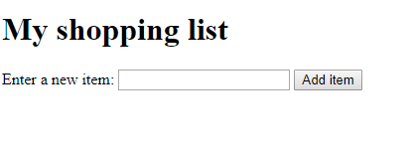
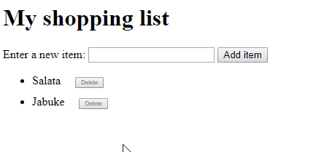
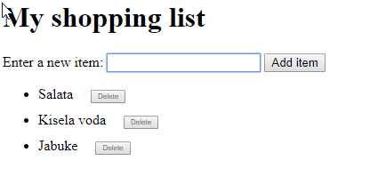
Shopping list

Slide 7
Image gallery
https://developer.mozilla.org/en-US/docs/Learn/JavaScript/Building_blocks/Image_gallery

